Slide 1



















Job Application Tracker
COMPANY
ROLE
STATUS
NEXT STEP
APPLIED
Applied
--/--/----
Screening
--/--/----
Interview
--/--/----
Offer
--/--/----
Rejected
--/--/----
Organize, Monitor, and Succeed in Your Job Search
November 9, 2026

Slide 2



Why Track Your Job Applications?
Manage multiple applications efficiently
Increase your follow-up success rate
Reduce missed deadlines and opportunities
70%
of job seekers
lose track of applications
without a system

Slide 3



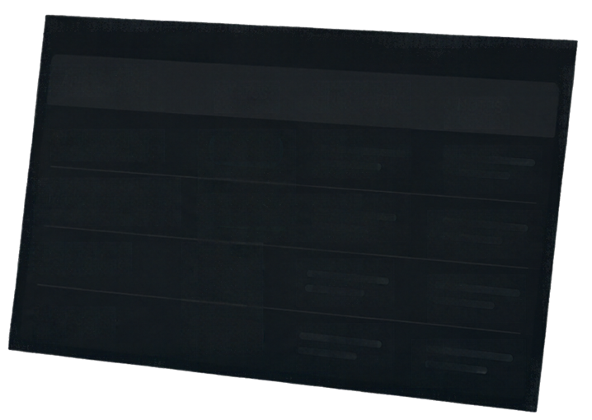












Key Features of the Tracker
APPLICATION
STATUS
NEXT STEP
NOTES
Product Manager
Applied
Marketing Specialist
Interviewing
Track every status
See where each application stands
Data Analyst
Offer
UX Designer
Stay on top of dates
Rejected
Never miss a deadline or follow-up
Organize job details
Keep company and role info in one place
Add personal notes
Capture impressions and next steps

Slide 4

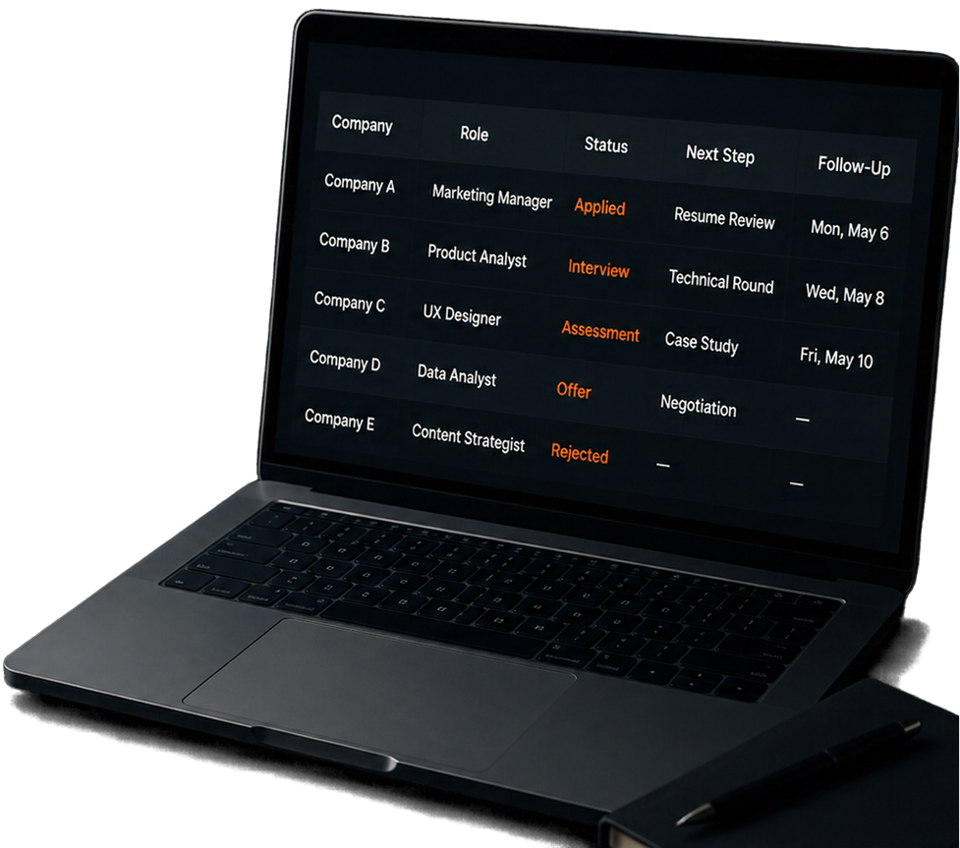




How to Use the
Job Application Tracker
Enter job details immediately after application
1
Update status as you progress through hiring stages
2
Set reminders for follow-ups and deadlines
3
Review and analyze your
progress weekly
4

Slide 5



Benefits and Next Steps
Stay organized and proactive in your job search
Improve response times and
interview preparendness
Start your tracker today and
customize it to fit your needs
Track smart,
land your dream job!

